Slide 1
S
C
R
A
B
B
L
E
1
3
1
1
3
3
1
1
P
R
O
J
E
C
T
3
1
1
8
1
3
1
Team Members:
Praveen Kumar, Allison Liu, Harsha Podapati, Dev Rao, Nick Seeman

Slide 2
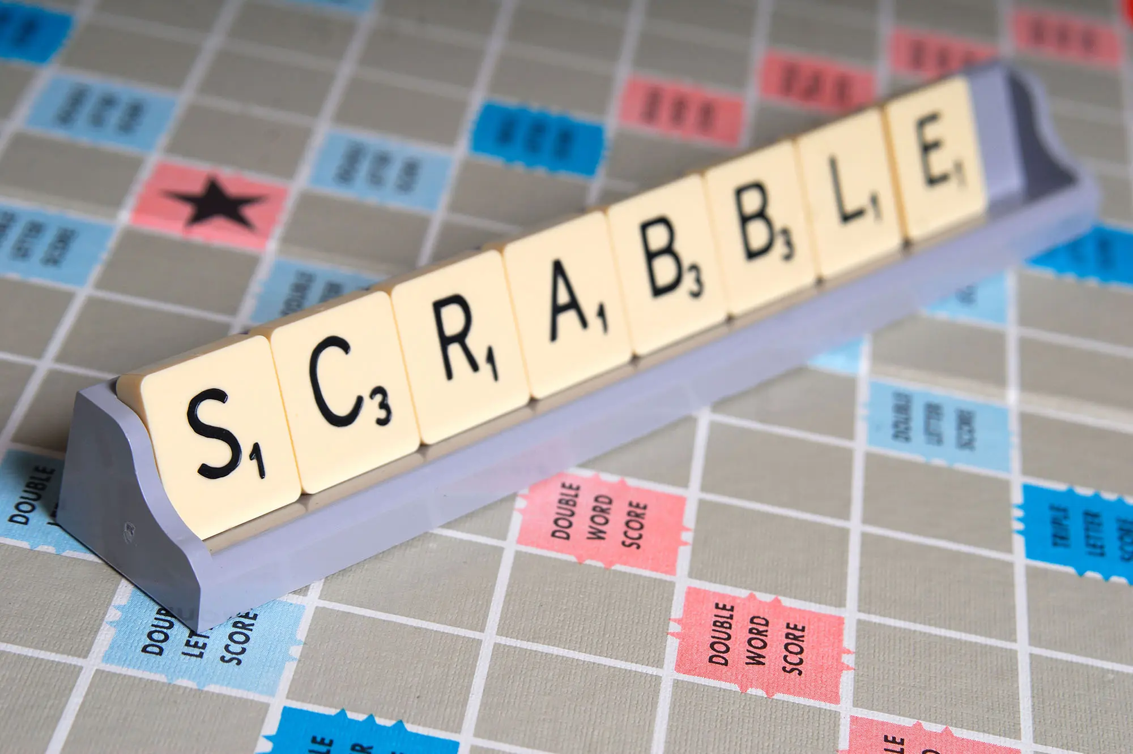
Agenda
Challenge
Rules for our situation
Dataset structures
Feature engineering
Model comparison
Best model
Business values

Slide 3
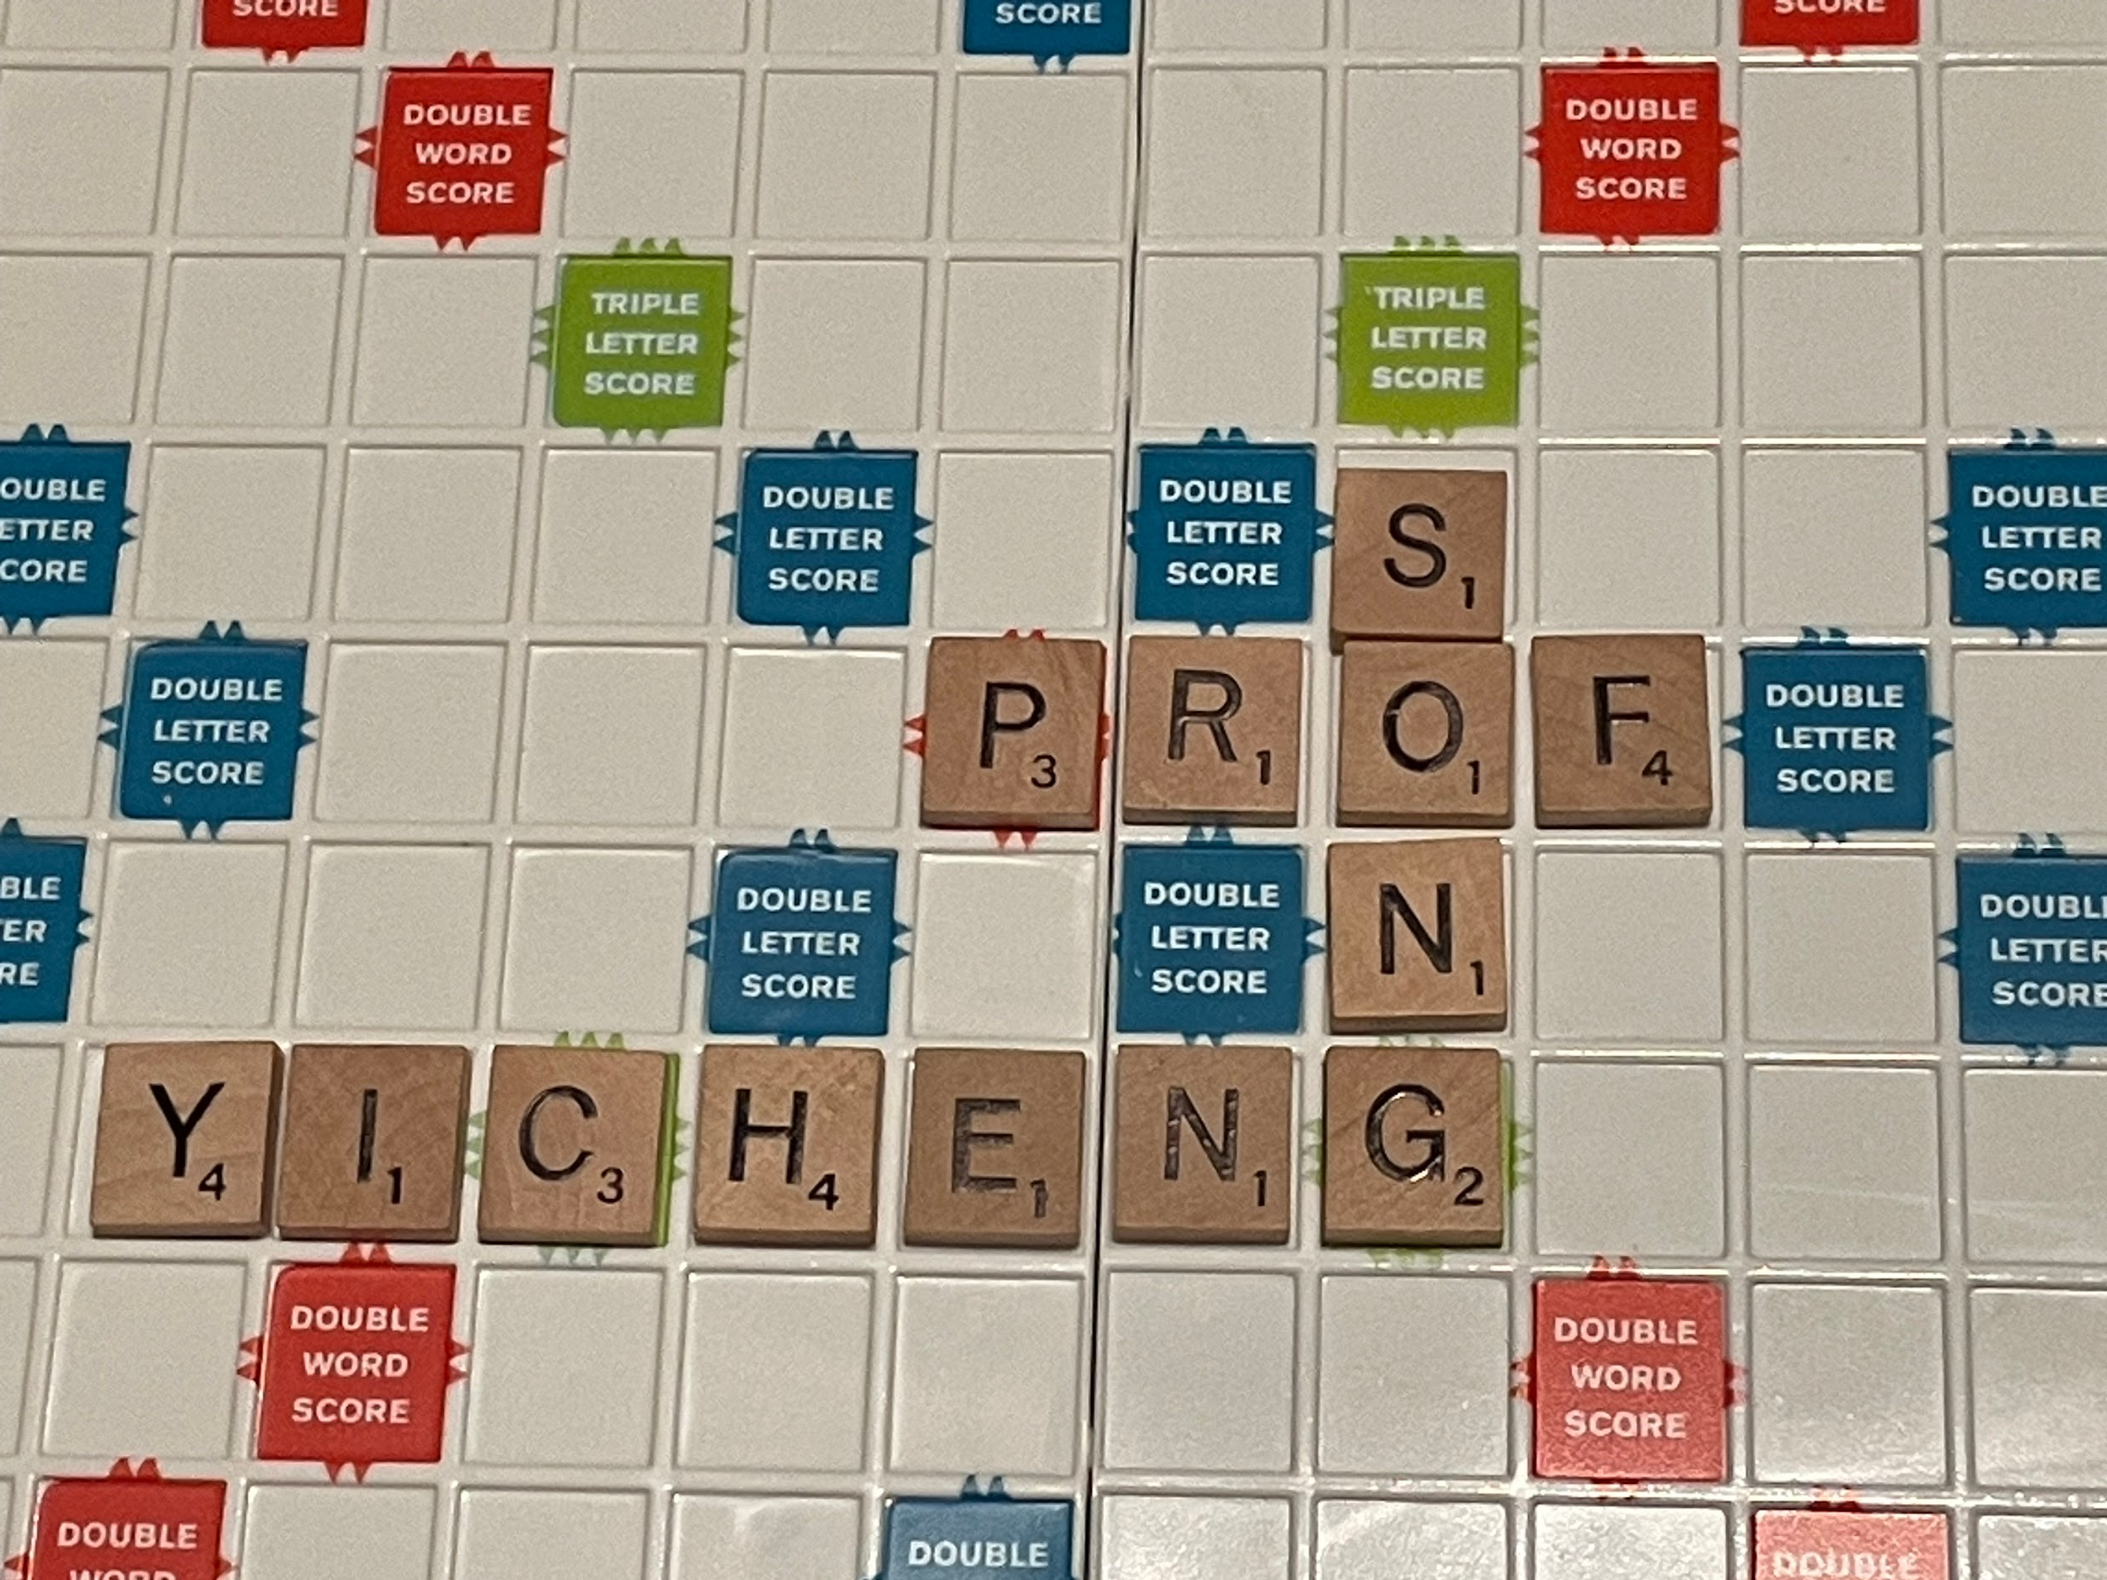
Challenge
Goal:
To predict players’ Scrabble rating
How to accomplish goal:
Create new features from these datasets
Build multiple predictive models
Evaluate and decide best model

Slide 4
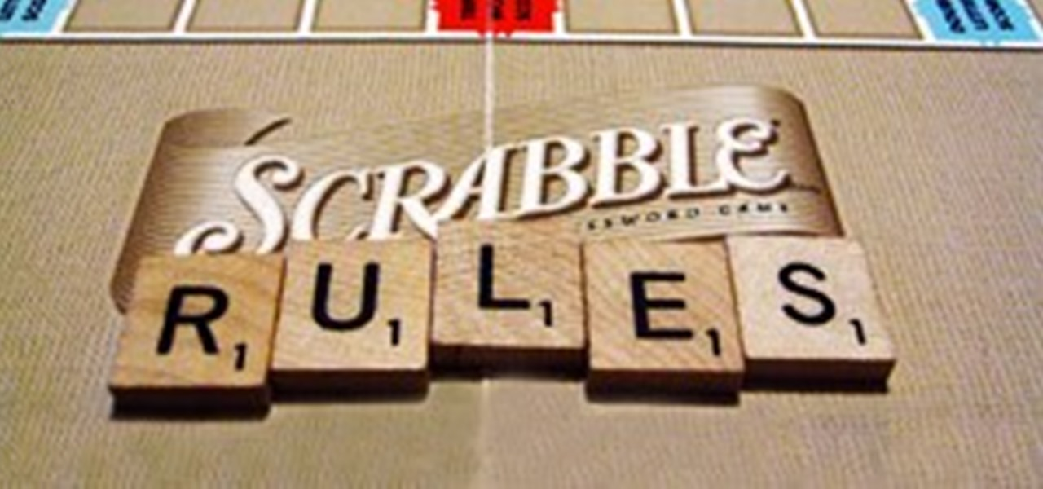
Unique Rules for our Situation
Rules:
Normal rules of Scrabble
One vs One style games
Player vs Bot games
Different game dictionaries
Notes:
Mention normal scrabble rules are in play
Each play is again a bot
And that there are three different dictionaries

Slide 5
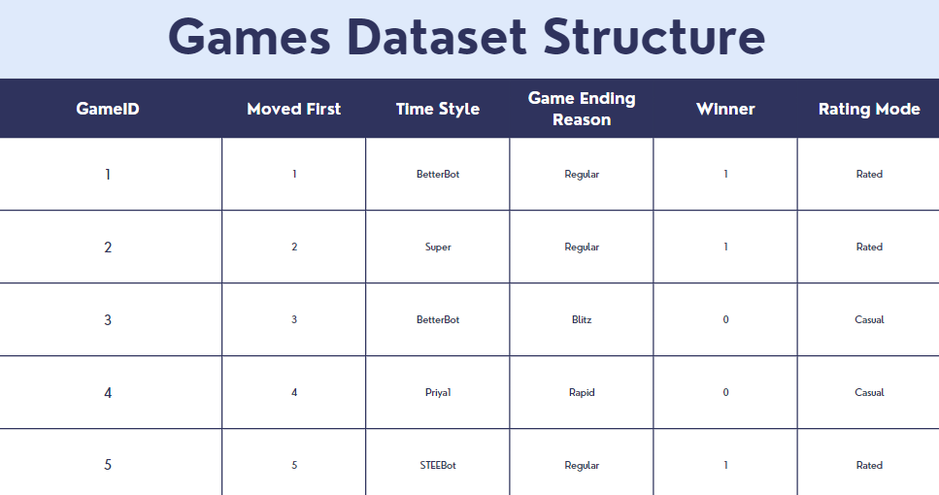
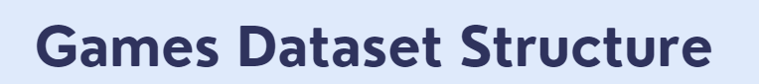
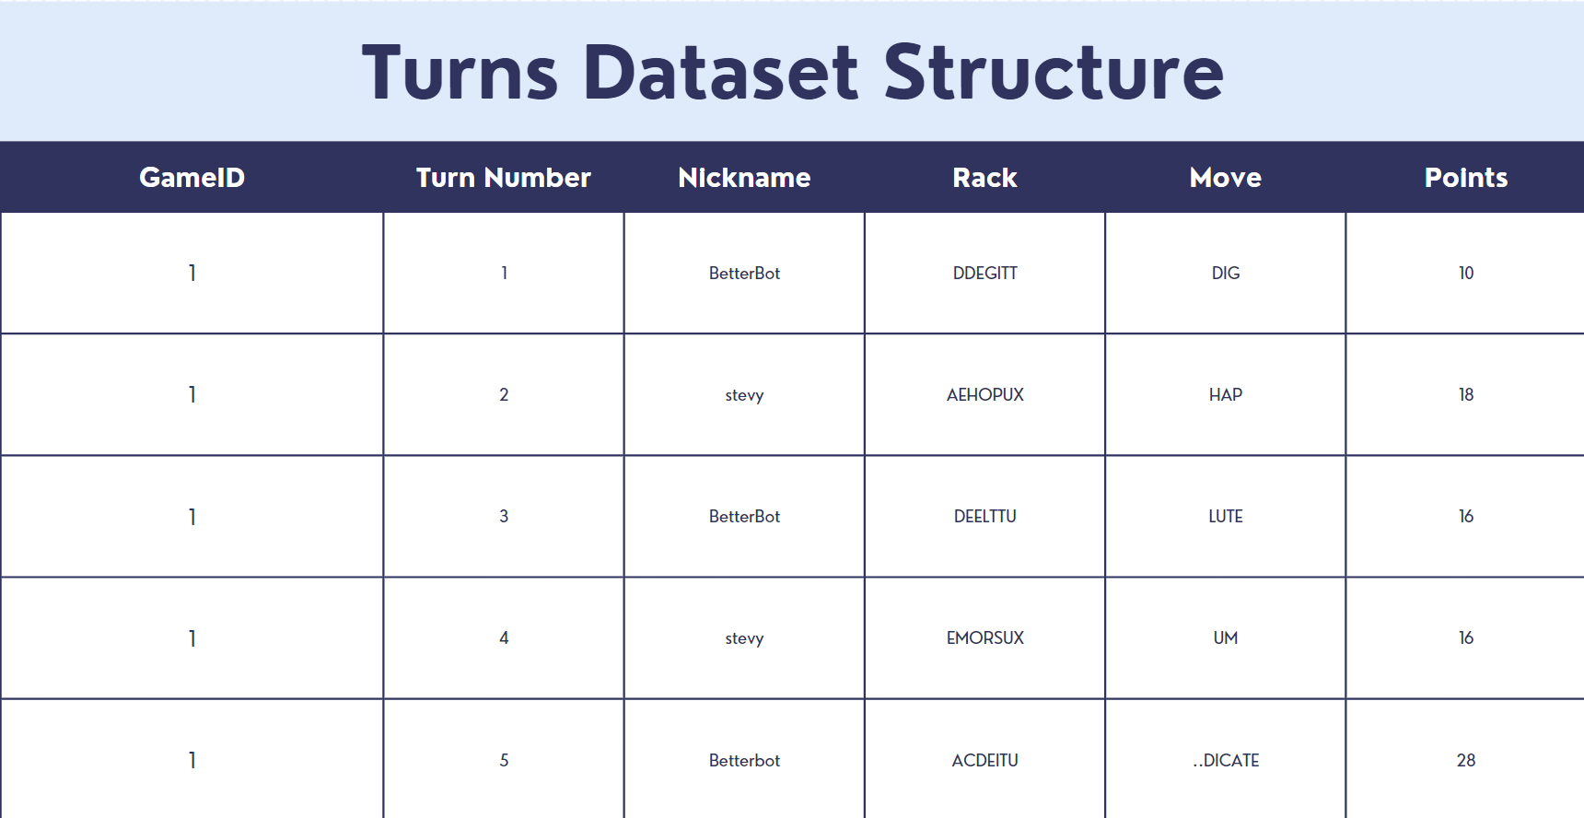
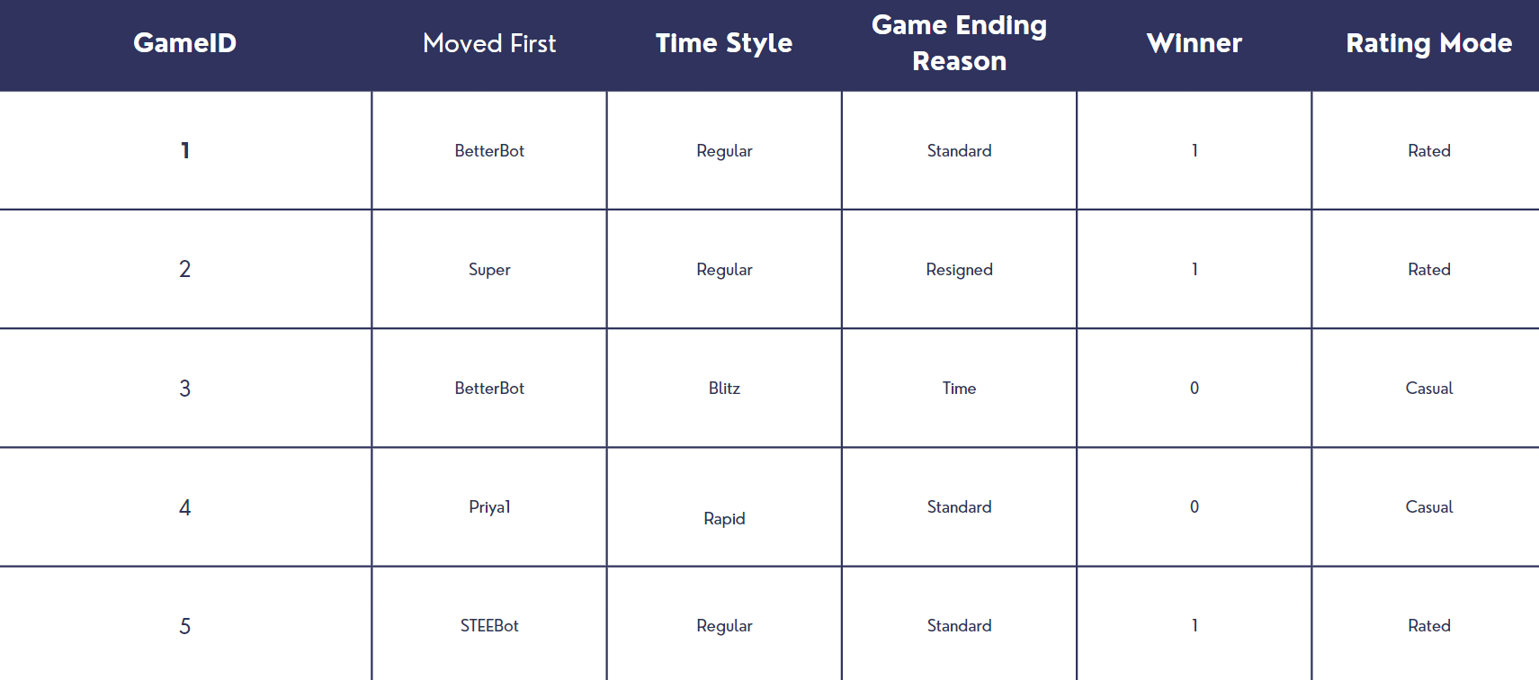
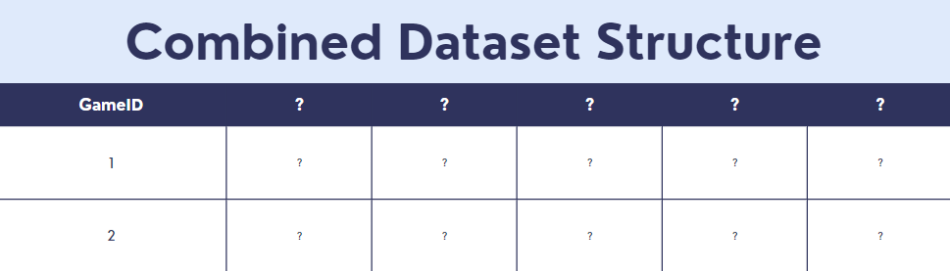
Dataset Structures
Two datasets:
Games dataset
Turns dataset
Task:
Create a singular dataset to build our model on .
Notes:
Click to load game dataset
Click again to highlight the first column. Walk them through the first column help them understand how the data is structured
Click again to make it all go away
Click again to do the turn dataset
Click again to highlight the first column. Walk them through the first column and explain the differences between this dataset and the games data. Mainly how the game id repeats in the turns.
Click to make it all go away
Click again to display the goal of combining both datasets together into a dataset to build our model on. Explain the value of historical metrics and that we need to engineer features as a transition to the next slide.

Slide 6
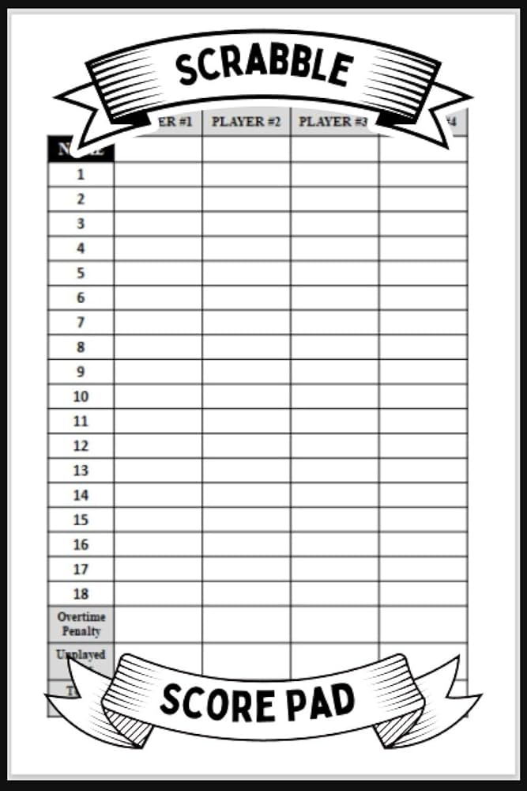
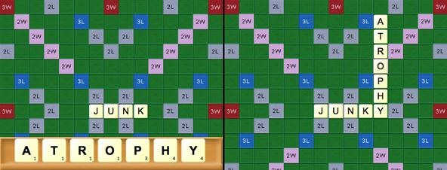
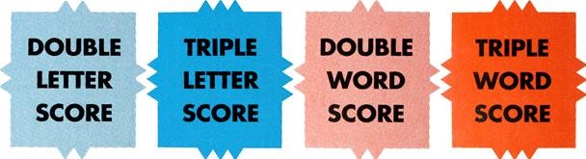
Feature Engineering
Board Metrics:
Special tile count
Double word/Letter
Triple word/Letter
Game Metrics:
Count of high value letter
JQXZ
Bingo
Player Metrics:
Score
Historical player score
Last game won
Notes:
Click once to talk about the board metrics. The image is of those special tiles.
Click to make it disappear
Click once to talk about game metrics. Mention just like how we counted “high” value tiles which are tiles greater than or equal 8 points by themself
Click to make it disappear
Click to make player metrics appear. Talk about historical player score and importance of if. Mention last game won.
Feature engineering is the most challenging and the most fascinating aspect of this project.
All that we have at our disposal is the data of the games that the players played against bots. We as data scientists are keen to engineer those features from the data that could explain and predict how high or how low the player rating could be.
Here, We looked at three different aspects of metrics. Firstly the board metrics. What does it actually mean? There are special tiles in the scrabble board which when used will give player bonus points, the player who leverages that the most indicate how good the player is and his rating will be.
Although these arenot directly available in the dataset, we went above and beyond to build the scrabble board from the turns dataset which was provided, we recreated the game that the player played in 2D matrix and extracts the usage of these special tiles.
Next we go to game metrics, it is indicative of how well the players adjust to the game. For example, The usage of special high value letters in the rack like JQXZ, carries more points, and if they use all the letters in the rack they get a bingo, which is a huge bonus, these features and many others like these are extracted from the dataset game wise.
Next we go to the historic player performance metrics. How well player has played over time, winning streak affects ratings a lot, we didn't want to ignore that aspect as well.
Together all these metrics brings and engineers out the nuances of the games as features for our predictive modeling.

Slide 7
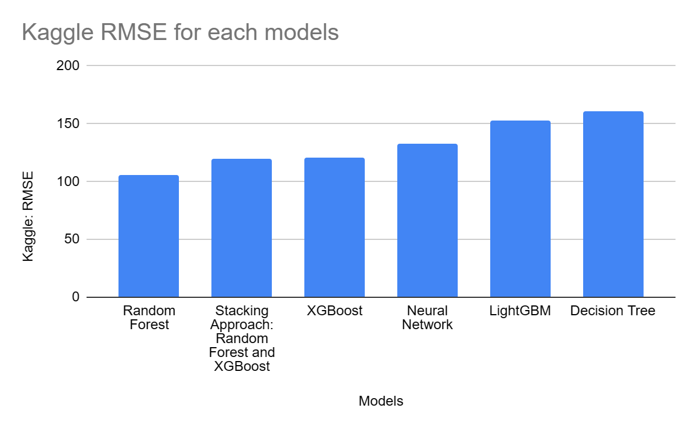
Model Comparison
Evaluation criteria:
RMSE (Root Mean Squared Error)
Measures average error
152.58
160.77
Models we are comparing:
Random Forest
Decision Tree
LightGBM
XGBoost
Neural Network
Stacking Approach: Random Forest and XGBoost
132.71
105.82
119.33
120.57
Notes:
Just make sure to explain that you explain what RMSE is “Measure of Average Error”. Besides that nothing really else besides just mentioning the models we noticed performed the best

Slide 8
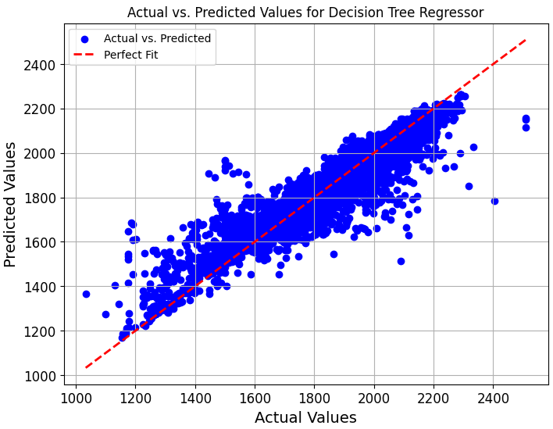
Best Model
Best Model:
Random Forest
RMSE: 105.82
Cross-validation choice:
Grid-Search
Tuned Hyperparameters:
Max-Depth: 8
Minimum Sample Leaf:1
Minimum Sample Split: 5
Number of Estimators: 50
Notes:
Possible way to explain hyperparameters easily.
Hyperparameter def: We choose the best configurations based on the lowest average difference between predicted and actual values
Explain what Grid-Search does: Tries every valuation and give you the best configuration of hyperparameters based on the metric of choice.
Explain the different kinds of hyperparmeters:
-Max-deph: a decisions tree cant be bigger than 8 nodes deep
-Minimum sample leaf: minimum number of samples in a leaf node
-Minimum Sample Split: the minimum amount of samples required to do a split
-Number of estimators: the number of trees in the random forest.

Slide 9
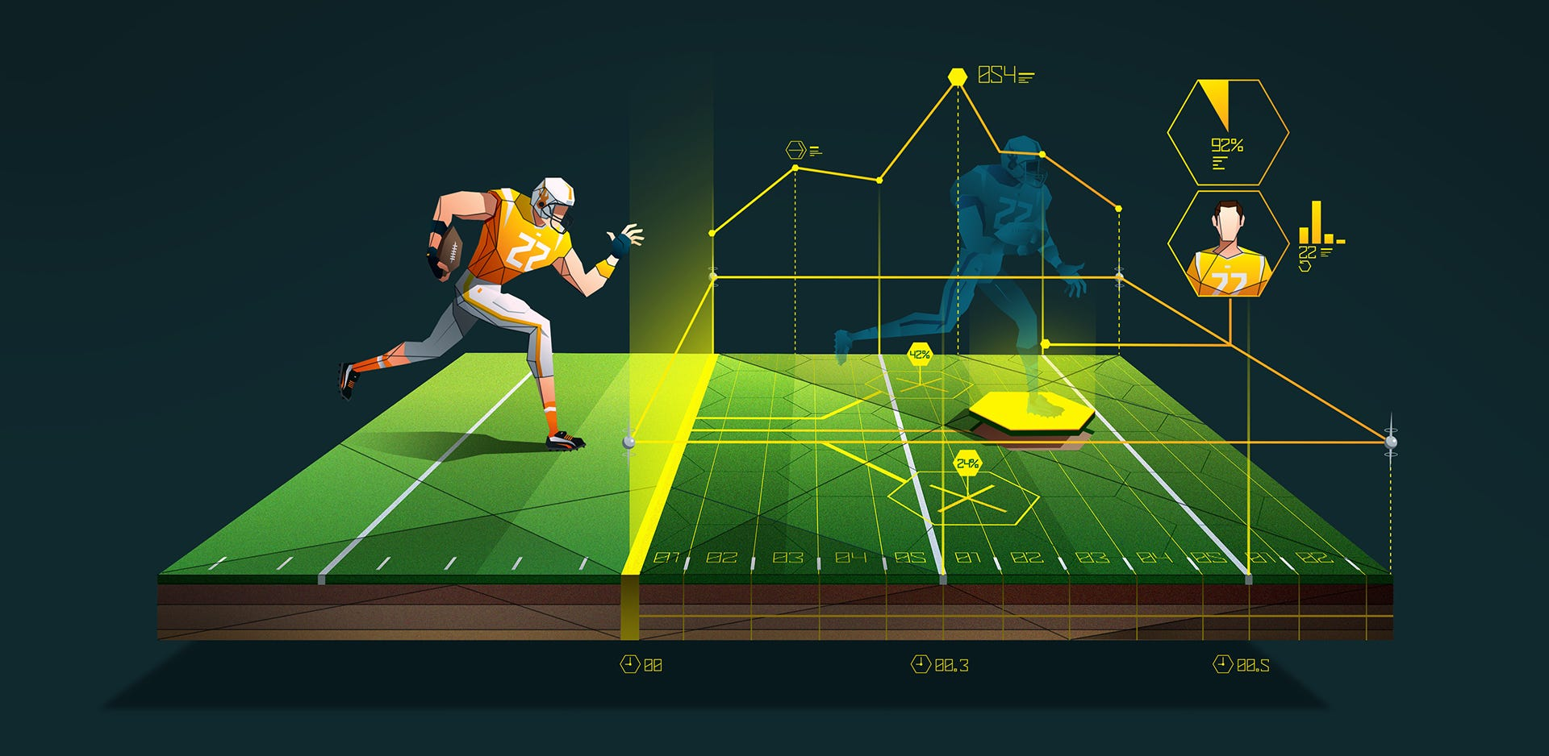
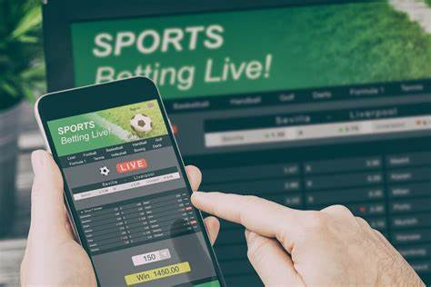
Business Values
Sports Industry
Similar data structure
Has turn based data
Players ratings
Be able to predict a player’s rating is beneficial to fantasy sports.
Gambling
Sports gambling is a massively growing industry.
Be able to predict team/player success.
Notes:
Just make sure to touch on how our data structure, and predictive methods were very similar.

Slide 10
T
H
A
N
K
1
4
1
1
5
Y
O
U
4
1
1

